Slide 1


3
Methods and Behaviors
C# Programming: From Problem Analysis to Program Design
4th Edition

Slide 2
Chapter Objectives
Become familiar with the components of a method
Call class methods with and without parameters
Use predefined methods in the Console and Math classes
Write your own value- and nonvalue-returning class methods (with and without parameters)
Distinguish between value, ref, and out parameter types

Slide 3
Chapter Objectives (continued)
Explore the use of named and optional parameters with default values
Work through a programming example that illustrates the chapter’s concepts

Slide 4
Anatomy of a Method
Methods defined inside classes
Group program statements
Based on functionality
Called one or more times
All programs consist of at least one method
Main( )
User-defined method

Slide 5
/* SquareExample.cs Author: Doyle */
using System;
namespace Square
{
public class SquareExample
{
public static void Main( )
{
int aValue = 768;
int result;
result = aValue * aValue;
Console.WriteLine("{0} squared is {1}", aValue, result);
Console.Read( );
}
}
}
Required method

Slide 6
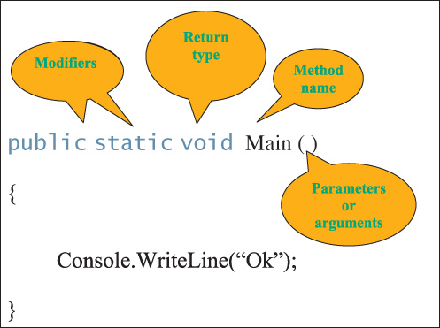
Anatomy of a Method (continued)
Figure 3-1 Method components

Slide 7
Modifiers
Appear in method headings
Appear in the declaration heading for classes and other class members
Indicate how it can be accessed
Types of modifiers
static
Access

Slide 8
static Modifier
Indicates member belongs to the type itself rather than to a specific object of a class
Main( ) must include static in heading
Methods that use static modifier - class methods
Instance methods require an object
Members of the Math class are static
public static double Pow(double, double)
double answer = Math.Sqrt(25);

Slide 9
Access Modifiers
public
protected
internal
protected internal
private

Slide 10
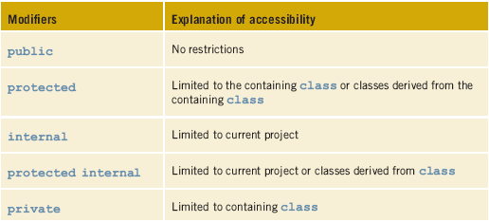
Level of Accessibility
Table 3-1 C# access modifiers

Slide 11
Return Type
Indicates what type of value is returned when the method is completed
Always listed immediately before method name
void
No value being returned
return statement
Required for all non-void methods
Compatible value

Slide 12
Return Type (continued)
Return type
public static double CalculateMilesPerGallon
(int milesTraveled, double gallonsUsed)
{
return milesTraveled / gallonsUsed;
}
Compatible value (double) returned

Slide 13
Method Names
Follow the rules for creating an identifier
Pascal case style
Action verb or prepositional phrase
Examples
CalculateSalesTax( )
AssignSectionNumber( )
DisplayResults( )
InputAge( )
ConvertInputValue( )

Slide 14
Parameters
Supply unique data to method
Appear inside parentheses
Include data type and an identifier
In method body, reference values using identifier name
Parameter refers to items appearing in the heading
Argument for items appearing in the call
Formal parameters
Actual arguments

Slide 15

Parameters (continued)
public static double CalculateMilesPerGallon
(int milesTraveled, double gallonsUsed)
{
return milesTraveled / gallonsUsed;
}
Call to method inside Main( ) method
Console.WriteLine("Miles per gallon = {0:N2}",
CalculateMilesPerGallon(289, 12.2));
Two formal parameters
Actual arguments

Slide 16
Parameters (continued)
Like return types, parameters are optional
Keyword void not required (inside parentheses) – when there are no parameters
public void DisplayMessage( )
{
Console.Write("This is ");
Console.Write("an example of a method");
Console.WriteLine("body.");
return; // no value is returned
}

Slide 17
Method Body
Enclosed in curly braces
Include statements ending in semicolons
Declare variables
Do arithmetic
Call other methods
Value-returning methods must include return statement

Slide 18
Calling Class Methods
Also called invoking a method
Call to method that returns no value [qualifier].MethodName(argumentList);
Qualifier
Square brackets indicate optional
Class or object name
Call to method does not include data type
Use IntelliSense

Slide 19
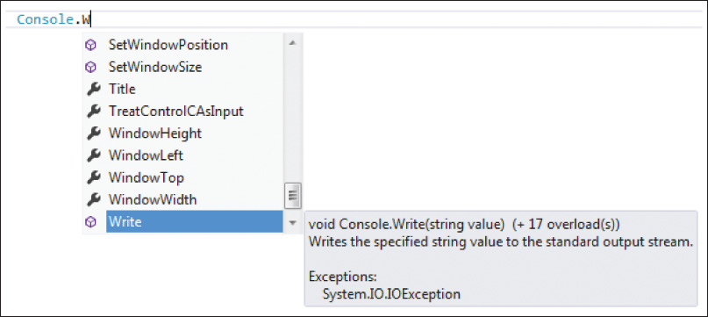
IntelliSense
After typing the dot, list of members pops up
Method signature(s) and description
3-D box —member methods
Figure 3-2 Console class members

Slide 20
Predefined Methods
C# has extensive class library
Classes have number of predefined methods
Console class (in System namespace)
Overloaded methods
Multiple methods with same name, but each has different number or type of parameter

Slide 21
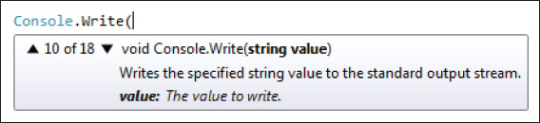
IntelliSense Display
string argument expected
string parameter
18 different Write( ) methods
Figure 3-3 IntelliSense display

Slide 22
Predefined Methods
Console class
Overloaded methods
Write( )
WriteLine( )
Read( )
Not overloaded
Returns an integer

Slide 23
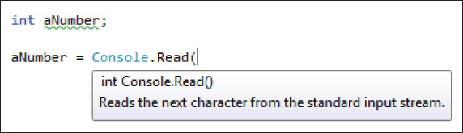
Read( ) Method
Figure 3-4 Console.Read ( ) signature

Slide 24
Call Read( ) Methods
int aNumber;
Console.Write("Enter a single character: ");
aNumber = Console.Read( );
Console.WriteLine("The value of the character entered: "
+ aNumber);
Enter a single character: a
The value of the character entered: 97

Slide 25
Call Read( ) Methods (continued)
int aNumber;
Console.WriteLine("The value of the character entered: "
+ (char) Console.Read( ));
Explicit cast
Enter a single character: a
The value of the character entered: a

Slide 26
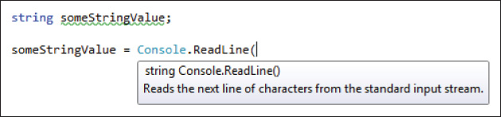
ReadLine( )
Returns string
Not overloaded
Returns characters entered up to the enter key
Figure 3-5 Console.ReadLine ( ) signature

Slide 27
Call ReadLine( ) Methods
More versatile than the Read( )
Returns all characters up to the enter key
Not overloaded
Always returns a string
String value must be parsed

Slide 28
/* AgeIncrementer.cs Author: Doyle */
using System;
namespace AgeExample
{
public class AgeIncrementer
{
public static void Main( )
{
int age;
string aValue;
Console.Write("Enter your age: ");
aValue = Console.ReadLine( );
age = int.Parse(aValue);
Console.WriteLine("Your age next year"
+ " will be {0} ", ++age);
Console.Read( );
} } }

Slide 29
ReadKey( )
Obtains next character entered by user
Used to hold screen
Can be called if you want to allow user to press any key after they finished reading
Not overloaded
Console.ReadKey( );

Slide 30
Call Parse( )
Predefined static method
All numeric types have a Parse( ) method
double.Parse("string number")
int.Parse("string number")
char.Parse("string number")
bool.Parse("string number")
Expects string argument
Argument must be a number – string format
Returns the number (or char or bool)

Slide 31
/* SquareInputValue.cs Author: Doyle */
using System;
namespace Square
{
class SquareInputValue
{
static void Main( )
{
string inputStringValue;
double aValue, result;
Console.Write("Enter a value to be squared: ");
inputStringValue = Console.ReadLine( );
aValue = double.Parse(inputStringValue);
result = Math.Pow(aValue, 2);
Console.WriteLine("{0} squared is {1} ", aValue, result);
Console.ReadKey( );
} } } // Curly braces should be lined up

Slide 32
Call Parse( ) (continued)
string sValue = " true ";
Console.WriteLine (bool.Parse(sValue)); // displays True
string strValue = "q";
Console.WriteLine(char.Parse(strValue)); // displays q

Slide 33
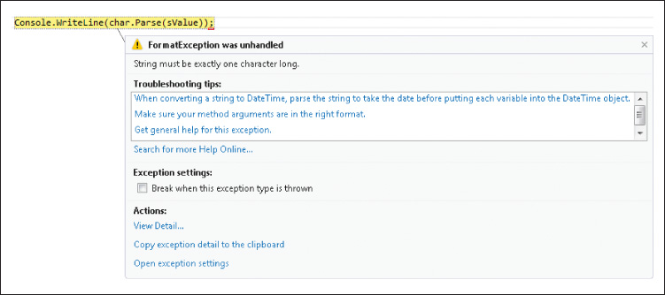
Call Parse( ) with Incompatible Value
Console.WriteLine(char.Parse(sValue));
when sValue referenced “True”
Figure 3-6 System.FormatException run-time error

Slide 34
Convert Class
More than one way to convert from one base type to another
System namespace — Convert class — static methods
Convert.ToDouble( )
Convert.ToDecimal( )
Convert.ToInt32( )
Convert.ToBoolean( )
Convert.ToChar( )
int newValue = Convert.ToInt32(stringValue);

Slide 35
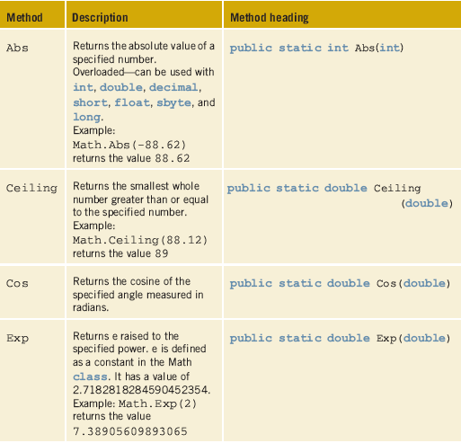
Methods in the Math class
Table 3-2 Math
class methods

Slide 36
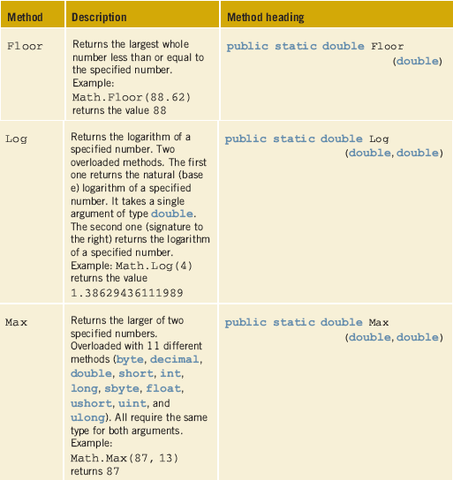
Math class (continued)
Table 3-2 Math
class methods

Slide 37
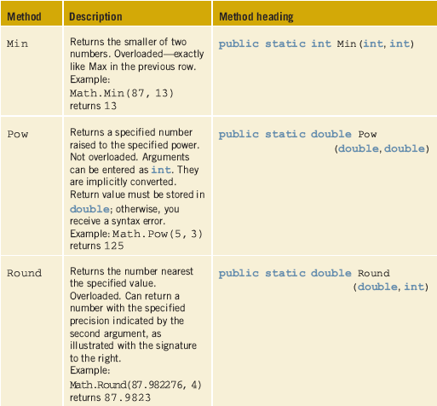
Math class (continued)
Table 3-2 Math
class methods

Slide 38
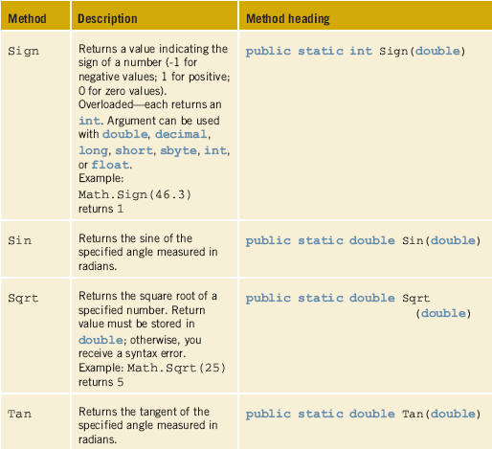
Math class (continued)
Table 3-2 Math
class methods

Slide 39
Math( ) Class
Each call returns a value
double aValue = 78.926;
double result1,
result2;
result1 = Math.Floor(aValue); // result1 = 78
result2 = Math.Sqrt(aValue); // result2 = 8.88403061678651
Console.Write("aValue rounded to 2 decimal places"
+ " is {0}", Math.Round(aValue, 2));
aValue rounded to 2 decimal places is 78.93

Slide 40
Method Calls That Return Values
In an assignment statement
Line 1 int aValue = 200;
Line 2 int bValue = 896;
Line 3 int result;
Line 4 result = Math.Max(aValue, bValue); // result = 896
Line 5 result += bValue *
Line 6 Math.Max(aValue, bValue) – aValue;
// result = 896 + (896 * 896 - 200) (result = 803512)
Line 7 Console.WriteLine("Largest value between {0} "
Line 8 + "and {1} is {2}", aValue, bValue,
Line 9 Math.Max(aValue, bValue));
Part of arithmetic expression
Argument to another method call

Slide 41
Writing Your Own Class Methods
[modifier(s)] returnType MethodName ( parameterList )
{
// body of method - consisting of executable statements
}
void Methods
Simplest to write
No return statement

Slide 42
Writing Your Own Class Methods – void Types
class method
Call to this method looks like:
DisplayInstructions( );
public static void DisplayInstructions( )
{
Console.WriteLine("This program will determine how "
+ "much carpet to purchase.");
Console.WriteLine( );
Console.WriteLine("You will be asked to enter the "
+ " size of the room and ");
Console.WriteLine("the price of the carpet, "
+ "in price per square yards.");
Console.WriteLine( );
}

Slide 43
Writing Your Own Class Methods – void Types (continued)
public static void DisplayResults(double squareYards,
double pricePerSquareYard)
{
Console.Write("Total Square Yards needed: ");
Console.WriteLine("{0:N2}", squareYards);
Console.Write("Total Cost at {0:C} ", pricePerSquareYard);
Console.WriteLine(" per Square Yard: {0:C}",
(squareYards * pricePerSquareYard));
}
static method called from within the class where it resides
To invoke method → DisplayResults(16.5, 18.95);

Slide 44
Value-Returning Method
Has a return type other than void
Must have a return statement
Compatible value
Zero, one, or more data items may be passed as arguments
Calls can be placed:
In assignment statements
In output statements
In arithmetic expressions
Or anywhere a value can be used

Slide 45
Value-Returning Method (continued)
public static double GetLength( )
{
string inputValue;
int feet, inches;
Console.Write("Enter the Length in feet: ");
inputValue = Console.ReadLine( );
feet = int.Parse(inputValue);
Console.Write("Enter the Length in inches: ");
inputValue = Console.ReadLine( );
inches = int.Parse(inputValue);
return (feet + (double) inches / 12);
}
Return type → double
double returned

Slide 46
CarpetExampleWithClassMethods
/* CarpetExampleWithClassMethods.cs */
using System;
namespace CarpetExampleWithClassMethods
{
public class CarpetWithClassMethods
{
public static void Main( )
{
double roomWidth, roomLength, pricePerSqYard,
noOfSquareYards;
DisplayInstructions( );
// Call getDimension( ) to get length
roomLength = GetDimension("Length");

Slide 47
CarpetExampleWithClassMethods (continued)
/* CarpetExampleWithClassMethods.cs */
using System;
namespace CarpetExampleWithClassMethods
{
public class CarpetWithClassMethods
{

Slide 48
public static void Main( )
{
double roomWidth, roomLength, pricePerSqYard,
noOfSquareYards;
DisplayInstructions( );
// Call getDimension( ) to get length
roomLength = GetDimension("Length");
roomWidth = GetDimension("Width");
pricePerSqYard = GetPrice( );
noOfSquareYards =
DetermineSquareYards(roomWidth, roomLength);
DisplayResults(noOfSquareYards, pricePerSqYard);
}

Slide 49
public static void DisplayInstructions( )
{
Console.WriteLine("This program will determine how much "
+ "carpet to purchase.");
Console.WriteLine( );
Console.WriteLine("You will be asked to enter the size of "
+ "the room ");
Console.WriteLine("and the price of the carpet, in price per"
+ " square yds.");
Console.WriteLine( );
}

Slide 50
public static double GetDimension(string side )
{
string inputValue; // local variables
int feet, // needed only by this
inches; // method
Console.Write("Enter the {0} in feet: ", side);
inputValue = Console.ReadLine( );
feet = int.Parse(inputValue);
Console.Write("Enter the {0} in inches: ", side);
inputValue = Console.ReadLine( );
inches = int.Parse(inputValue);
// Note: cast required to avoid int division
return (feet + (double) inches / 12);
}

Slide 51
public static double GetPrice( )
{
string inputValue; // local variables
double price;
Console.Write("Enter the price per Square Yard: ");
inputValue = Console.ReadLine( );
price = double.Parse(inputValue);
return price;
}

Slide 52
public static double DetermineSquareYards
(double width, double length)
{
const int SQ_FT_PER_SQ_YARD = 9;
double noOfSquareYards;
noOfSquareYards = length * width / SQ_FT_PER_SQ_YARD;
return noOfSquareYards;
}
public static double DeterminePrice (double squareYards,
double pricePerSquareYard)
{
return (pricePerSquareYard * squareYards);
}

Slide 53
public static void DisplayResults (double squareYards,
double pricePerSquareYard)
{
Console.WriteLine( );
Console.Write("Square Yards needed: ");
Console.WriteLine("{0:N2}", squareYards);
Console.Write("Total Cost at {0:C} ", pricePerSquareYard);
Console.WriteLine(" per Square Yard: {0:C}",
DeterminePrice(squareYards,
pricePerSquareYard));
}
} // end of class
} // end of namespace

Slide 54
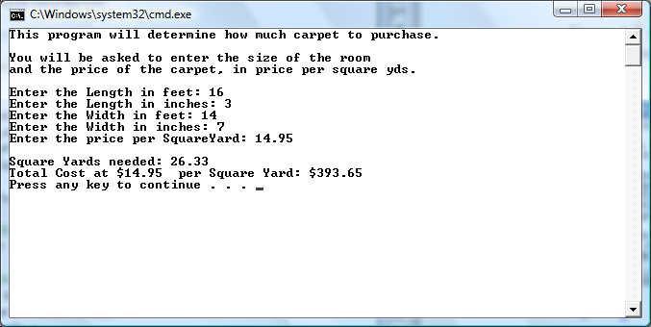
CarpetExampleWithClassMethods (continued)
Figure 3-7 Output from CarpetExampleWithClassMethods

Slide 55
Types of Parameters
Call by value
Copy of the original value is made
Other types of parameters
ref
out
params
ref and out cause a method to refer to the same variable that was passed into the method

Slide 56
Parameters Example
// Code pulled from Parameters.cs solutions
int testValue = 1;
TestDefault(testValue);
Console.WriteLine("Upon return from TestDefault "
+ "Value: {0}", testValue);
Console.WriteLine( );
public static void TestDefault(int aValue)
{
aValue = 111;
Console.WriteLine("In TestDefault - Value: {0}", aValue);
}
Upon return from TestDefault
Value: 1

Slide 57
Parameters Example (continued)
// Code pulled from Parameters.cs solutions
int testValue = 1;
TestRef(ref testValue);
Console.WriteLine("Upon return from TestRef "
+ "Value: {0}", testValue);
Console.WriteLine( );
public static void TestRef (ref int aValue)
{
aValue = 333;
Console.WriteLine("In TestRef - Value: {0}", aValue);
}
Upon return from TestRef
Value: 333

Slide 58
Parameters Example (continued)
// Code pulled from Parameters.cs solutions
int testValue2;
TestOut(out testValue);
Console.WriteLine("Upon return from TestOut "
+ "Value: {0}", testValue);
Console.WriteLine( );
public static void TestOut (out int aValue)
{
aValue = 222;
Console.WriteLine("In TestOut - Value: {0}", aValue);
}
Upon return from TestOut
Value: 222

Slide 59
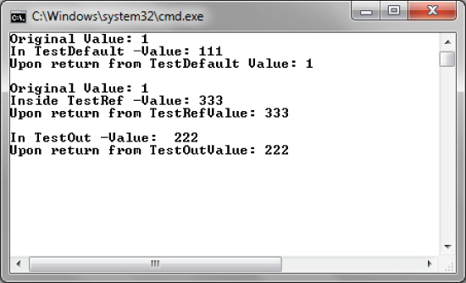
Parameters.cs
Figure 3-8 Output from ParameterClass example

Slide 60
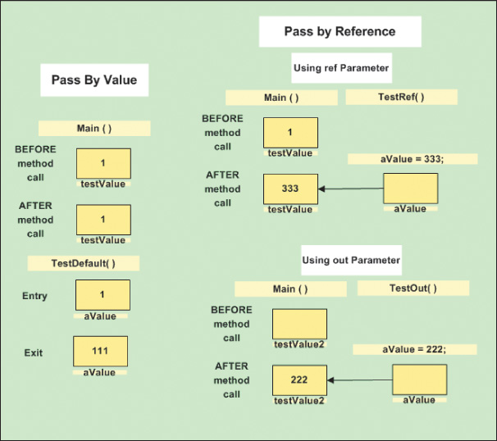
Types of Parameters (continued)
Figure 3-9 Call by reference versus value

Slide 61

Testing Parameters App
Comment/uncomment sections while testing
Figure 3-10 Visual Studio comment out icon

Slide 62
Optional Parameters
May assign default values to parameters
When you assign a default value to a parameter, it then becomes an optional parameter
public static void DoSomething(string name, int age = 21,
bool currentStudent = true, string major = "CS")
Can now call DoSomething( ) and send in arguments for the default value or the default values will be assigned to the parameters

Slide 63
Named Parameters
Named arguments free you from the need to remember or to look up the order of parameters for the method call
DoSomething (name: “Robert Wiser", age: 20);
DoSomething (name: "Paul Nelson", major: "BIO");
DoSomething (name: “Fredrick Terrell", age: 25,
major: “MS");

Slide 64
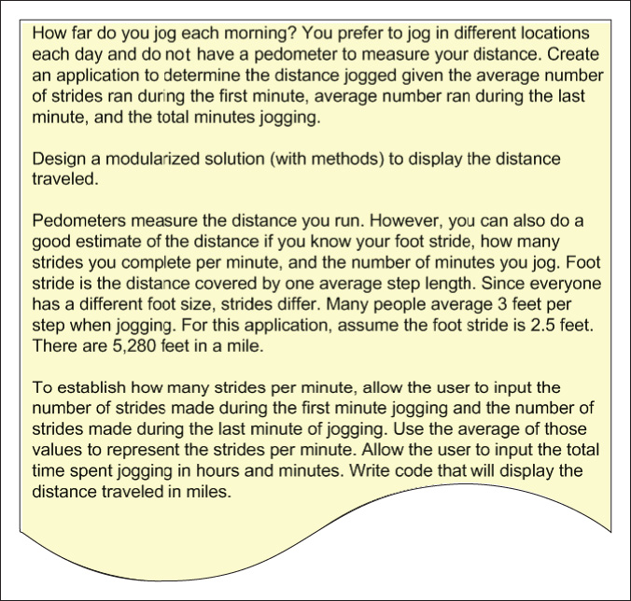
JoggingDistance Example
Figure 3-11 Problem specification for JoggingDistance example

Slide 65
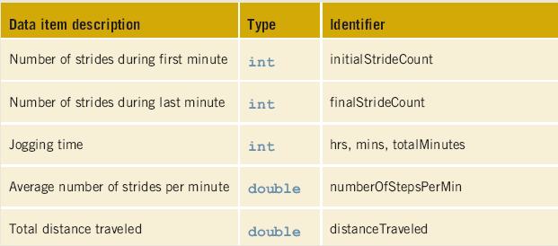
Data for the JoggingDistance Example
Table 3-3 Variables for JoggingDistance classes

Slide 66
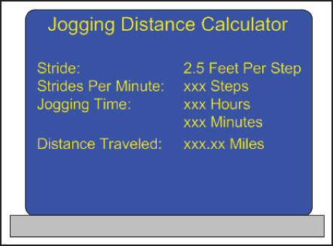
JoggingDistance Example (continued)
Figure 3-12 Prototype

Slide 67
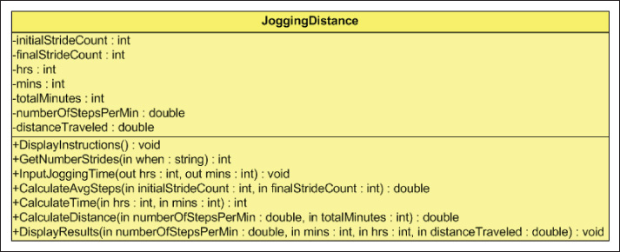
JoggingDistance Example (continued)
Figure 3-13 Class diagrams

Slide 68
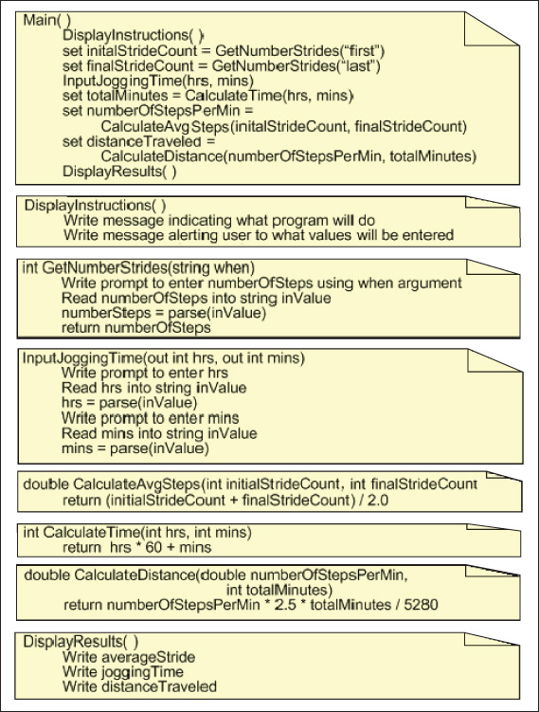
Figure 3-14 Structured English for the JoggingDistance example

Slide 69
Coding Standards
Naming conventions
Spacing conventions
Declaration conventions
Commenting conventions

Slide 70
Resources
C# Dev Center –
http://www.csharp.net
Code Gallery site –
http://code.msdn.microsoft.com
Methods (C# Programming Guide) –
http://msdn.microsoft.com/en-us/library/ms173114.aspx

Slide 71
Chapter Summary
Components of a method
Class methods
Parameters
Predefined methods
Value- and nonvalue-returning methods

Slide 72
Chapter Summary (continued)
Types of parameters
Optional parameters
Named parameters

